Slide 1

AGILE DEVELOPMENT METHODS AND ARTEFACTS
By – Kanaga Manikandan Solaikannan

Slide 2
What are agile methods?
Agile Methods are utilised by a team to work effectively and produce the best product.
We’ll be covering a few agile methods and how they were used in the software development exercise such as,
SCRUM Meetings
Product Backlog
Burndown Chart

Slide 3
What are scrum meetings?
These meetings take place daily to have a status update on the progress of the development.
The team members share their stories on what happened, what they plan to do and what problems they encountered.
Scrum Meetings are conducted by the Scrum Master of the team and they last for about 15 minutes.

Slide 4


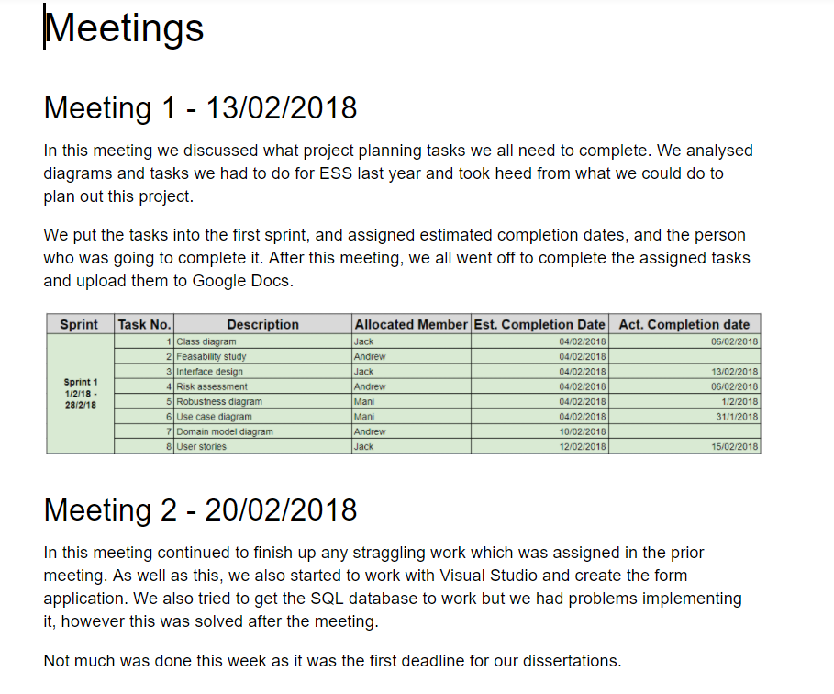
How were scrum meetings helpful?
Each team member got a knowledge of which team member is going to do which task and within how much time.
The team did not have a Scrum Master to conduct the meetings. So the team members do it among themselves every week.
By addressing the completed tasks, pending tasks and problems, the team was able to proceed with the development effectively.
Notes:
1st Point – The team members commit to themselves

Slide 5
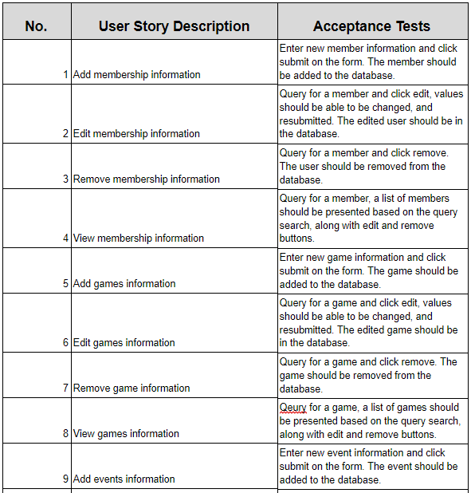
What is a product backlog?
Product Backlog is the list of things that needs to be done within the project.
The product backlog is owned by the Product Owner and decides which items in the list make it to the final product.
The product backlog is a living document.
Notes:
3rd Point – New items may be added to the product backlog and existing items may be modified or even removed.

Slide 6
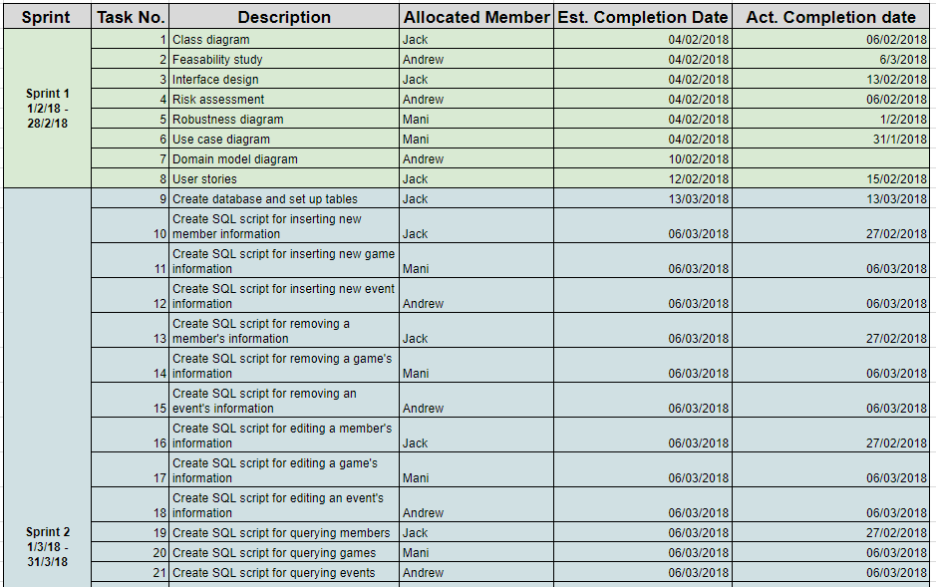
How was a product backlog helpful?
Product Backlog provided a knowledge on the scope and weight of the project.
Items in the Product Backlog became tasks estimated in hours and were placed in various sprints.
Sprints allowed the team members to finish a bulk of work within 2-30 days.
Notes:
New Point – The chosen items in the product backlog become the release backlog.

Slide 7
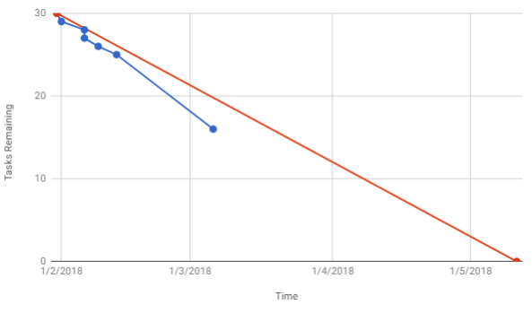
What is a burndown chart?
Burndown chart is a visual representation of the amount of work completed against time remaining.
A straight line is drawn from the start point to the end point. This line represents the estimated rate of completion.
If the line representing the actual rate of completion is above the straight line, then the team is behind schedule.
Notes:
2nd Point – Start point is the point at which no task is completed. End point is 0 meaning no tasks left
3rd Point – Mention the vice-versa
Mention the lines by colour

Slide 8
How was a burndown chart helpful?
The visual representation enabled the team members to have a clear idea on the current state of progress.
It allowed the team members to adapt to the current situation and manage their time more efficiently.
The future of the development process was easily predicted with the help of the burndown chart.
Notes:
3rd Point – Chart shows how many tasks are left, how many done allowing the team to predict the quality of the product

Slide 9
references
https://www.mountaingoatsoftware.com/agile/scrum/meetings/daily-scrum
https://www.scrum-institute.org/The_Scrum_Product_Backlog.php#
http://www.agilenutshell.com/burndown

